Slide 1

Social Media vs. Stock Market
Does Social Media sentiment have any effect on Stock Prices or Trading Volume?
-Tushar Rao

Slide 2
PURPOSE OF THE PROJECT
To find some correlation between the sentiment of tweets of a particular year and study their effect on the stock price/trading volume of certain companies.
This study of effect of tweets on stock prices was conducted on three companies:
Apple, Amazon, and Tesla

Slide 3
PREPARING DATA FOR SENTIMENT ANALYSIS
Various sentiment scores were generated using the syuzhet package in R, which is a library for used for text analysis.
Using a sentiment dictionary available in the package, based on occurrences of certain words and the tone of the tweet, scores for 8 emotions are assigned.
Anger, Anticipation, Disgust, Fear, Joy, Sadness, Surprise, Trust
Positive and Negative for tone of the tweet

Slide 4
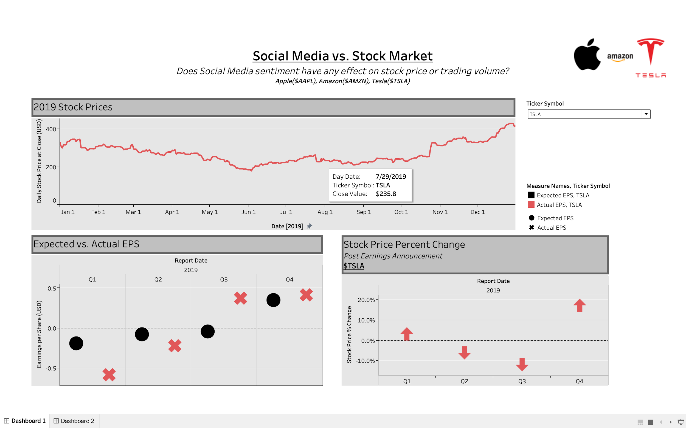

Slide 5
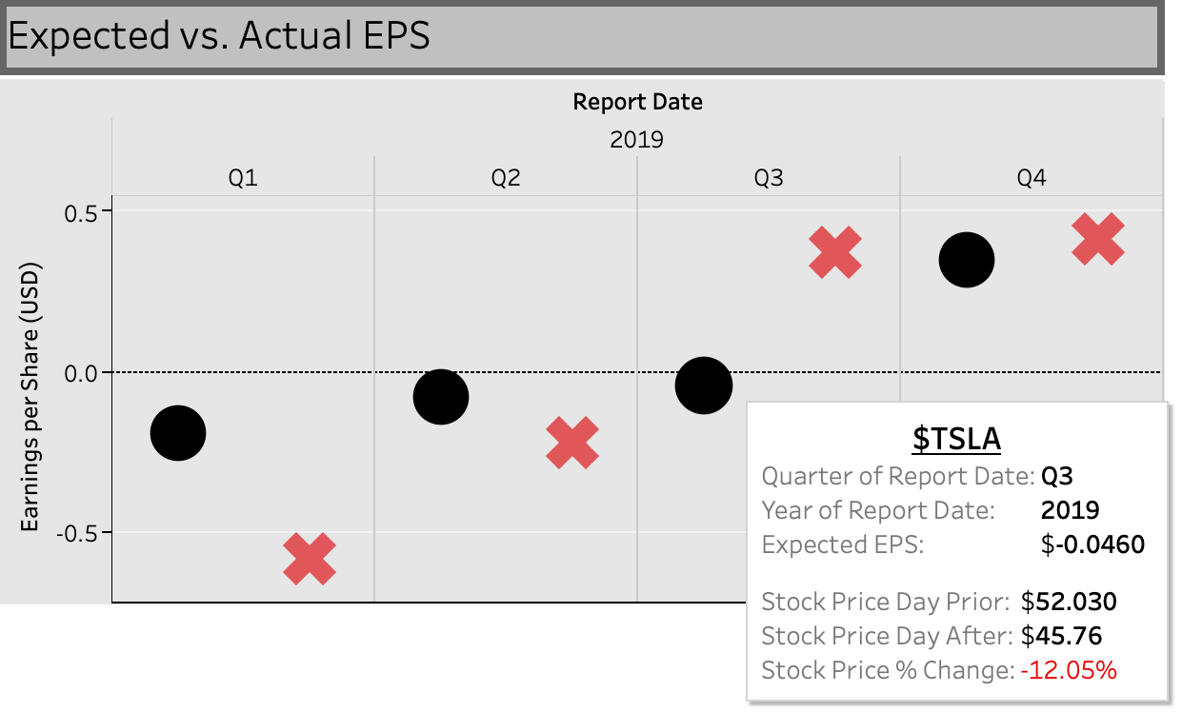

Slide 6
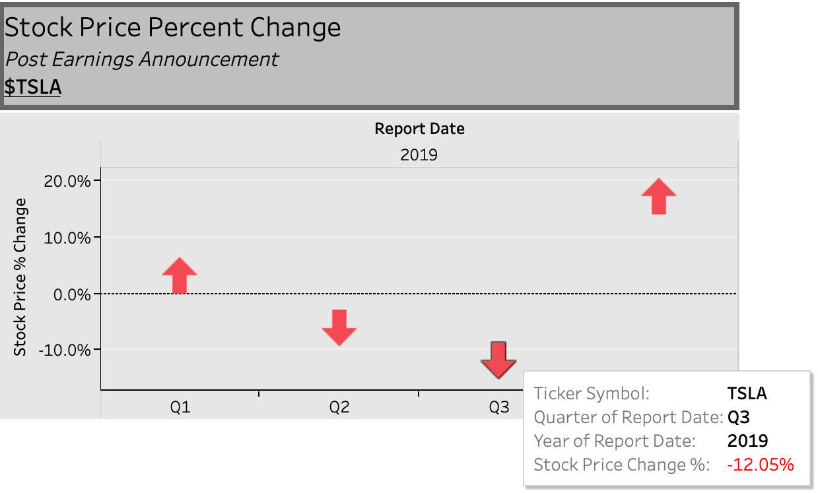

Slide 7
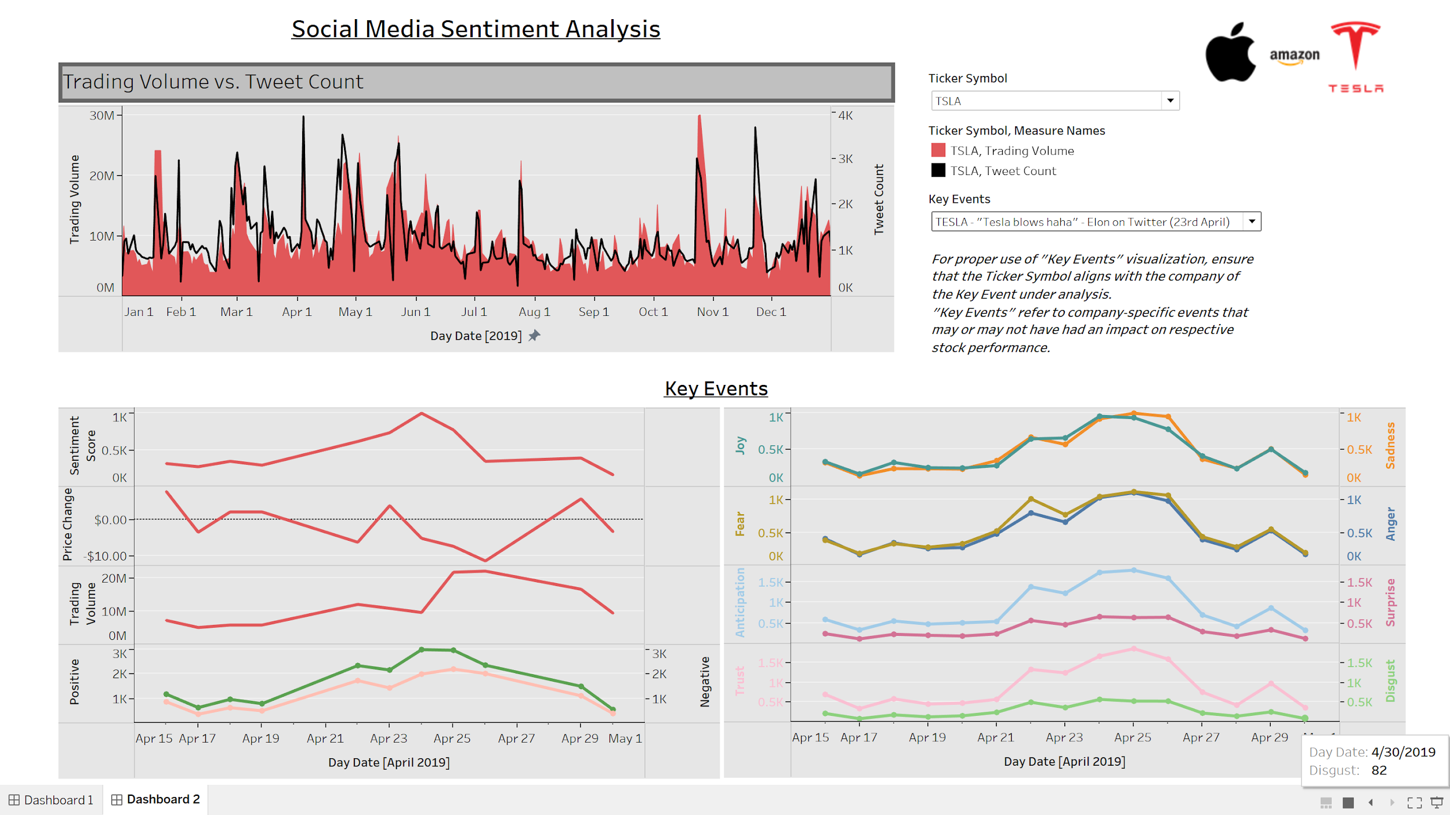

Slide 8
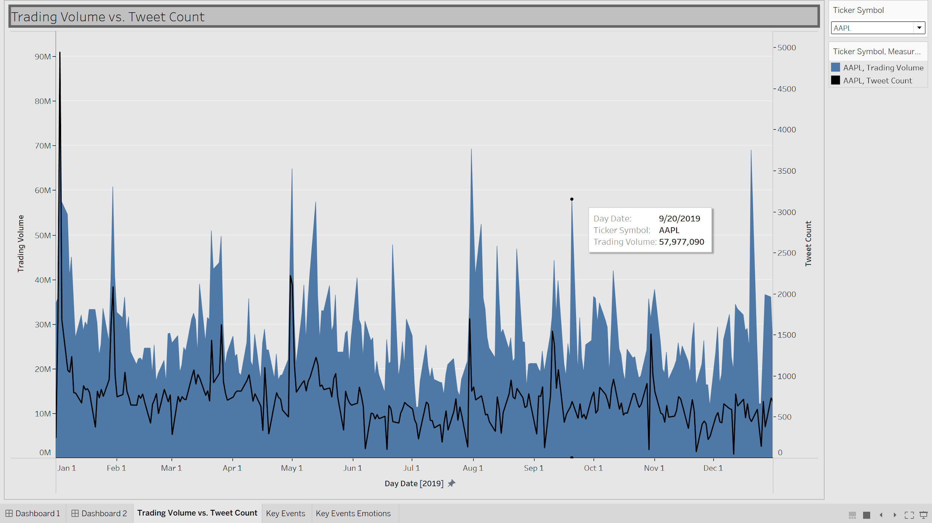
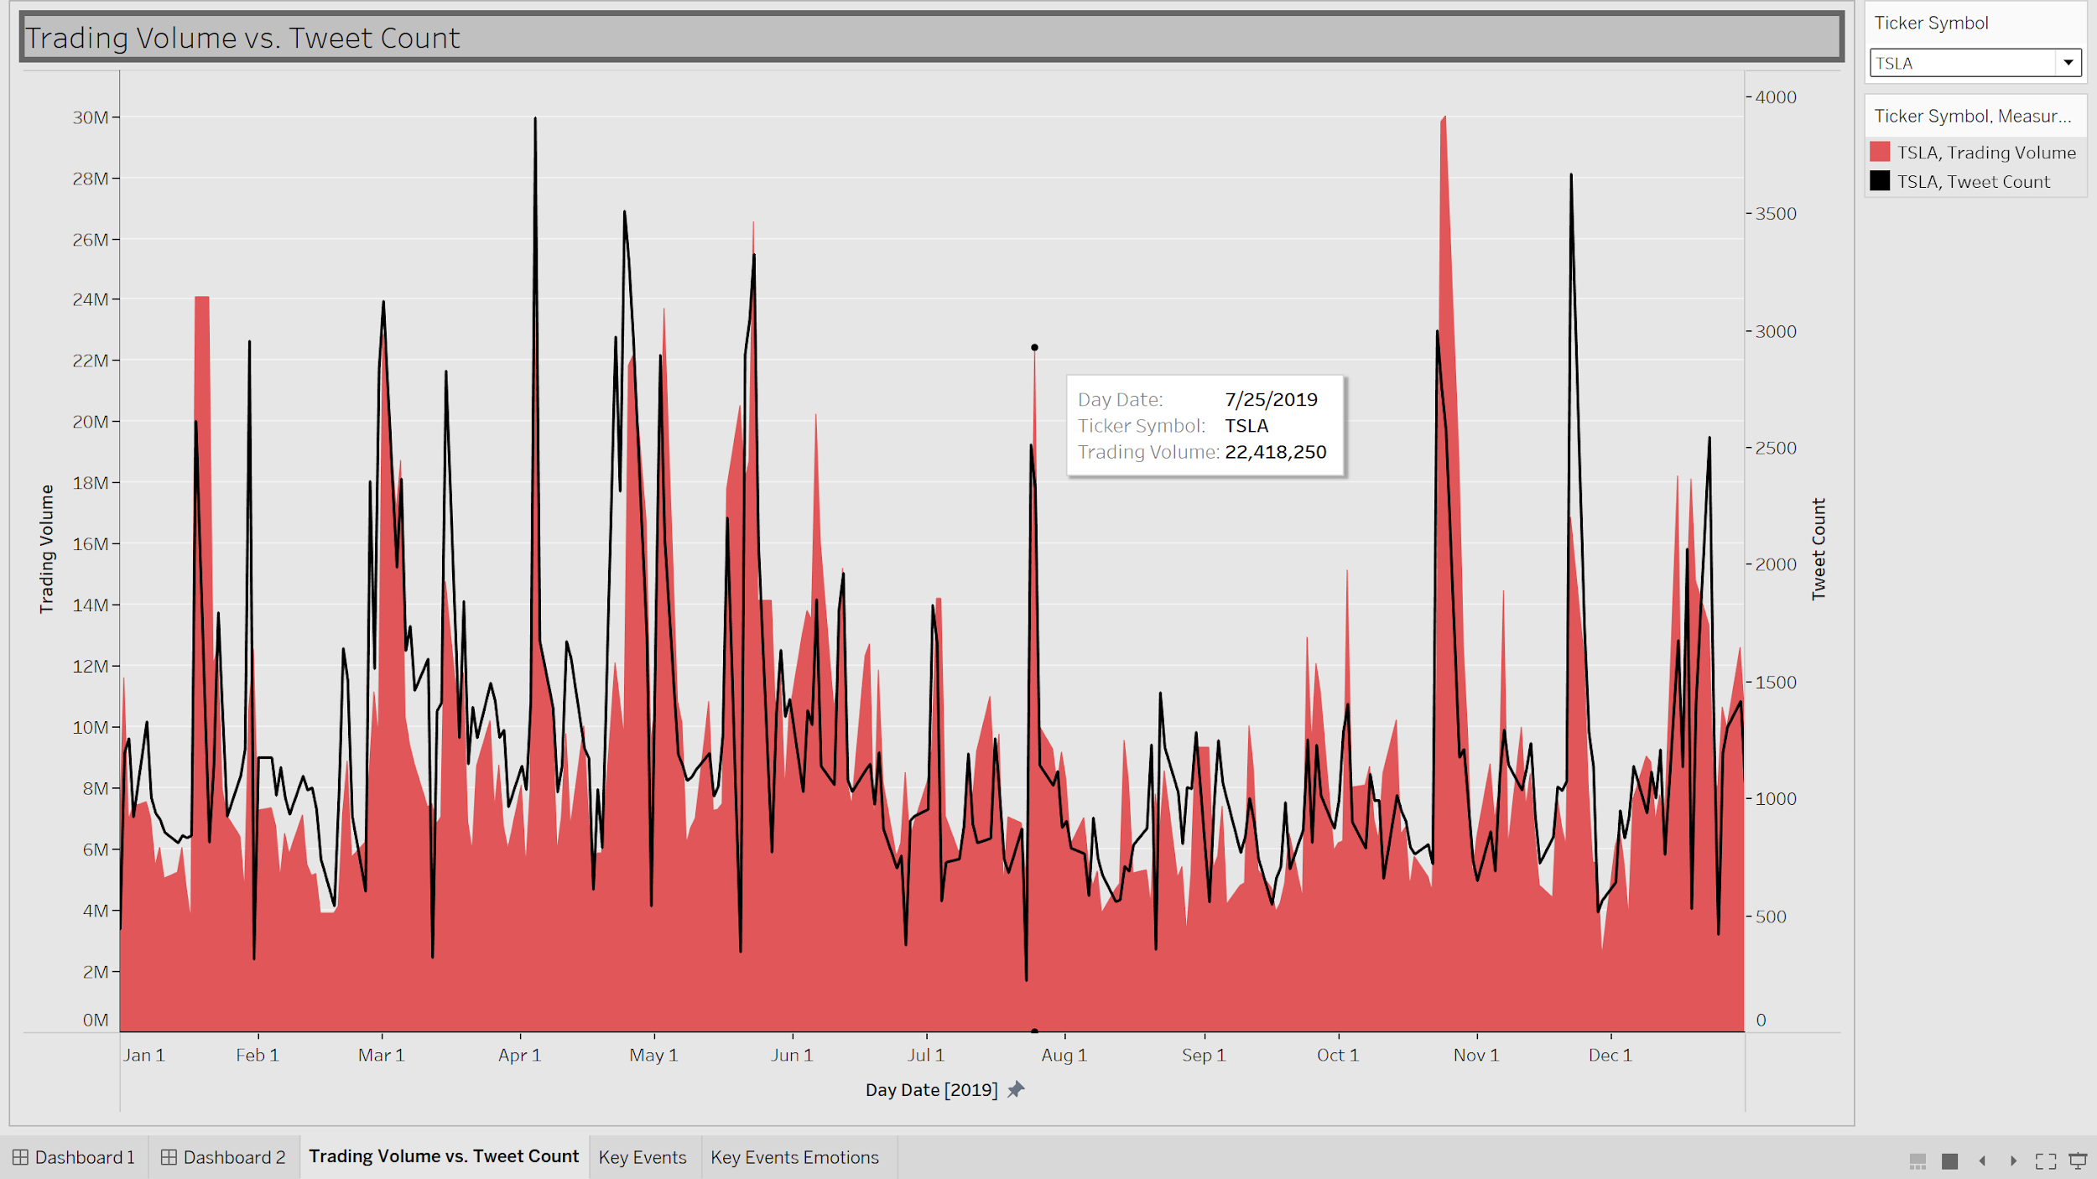
TRADING VOLUME VS. TWEET COUNT
In the case of very well-established organizations, like Apple (as shown here, in blue), effect of tweets on the trading volume is not as much as we would like to see.
This may be because of Apple being considered a “safe investment”, due to its low volatility.
In Tesla’s case (as shown, in red), we can see that the number of tweets does affect the trading volume.
On days when the number of tweets were high, trading volume was also more than usual.

Slide 9
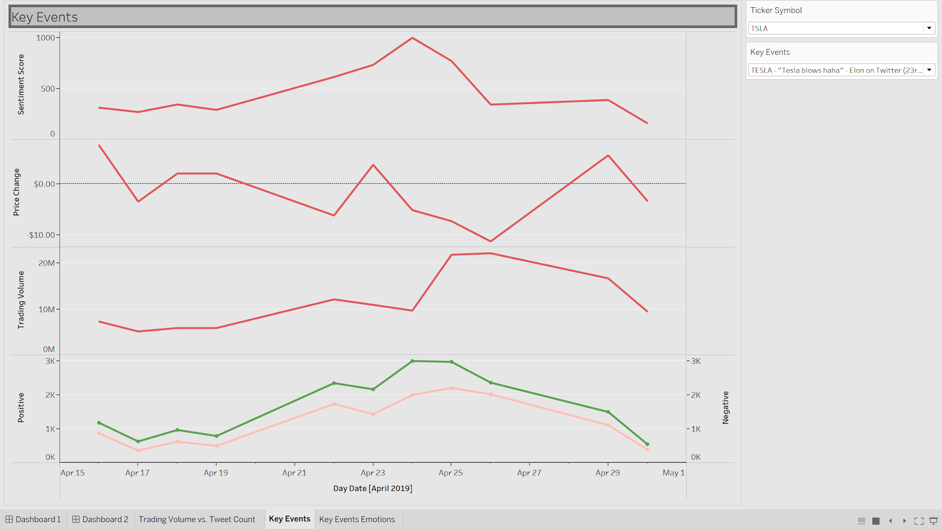
“Tesla blows haha” –Elon Musk Tweet

Slide 10
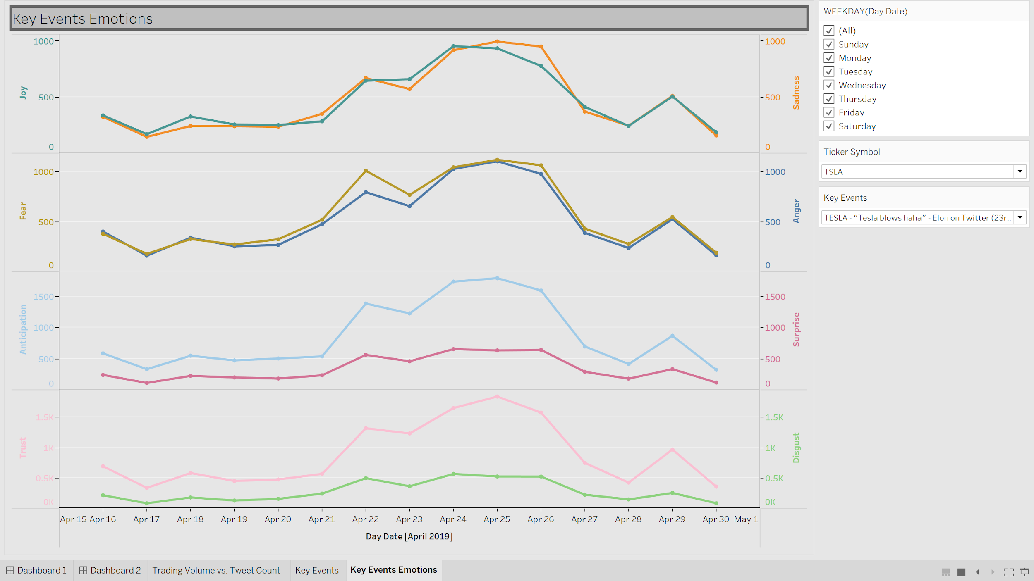
“Tesla blows haha” –Elon Musk Tweet

Slide 11
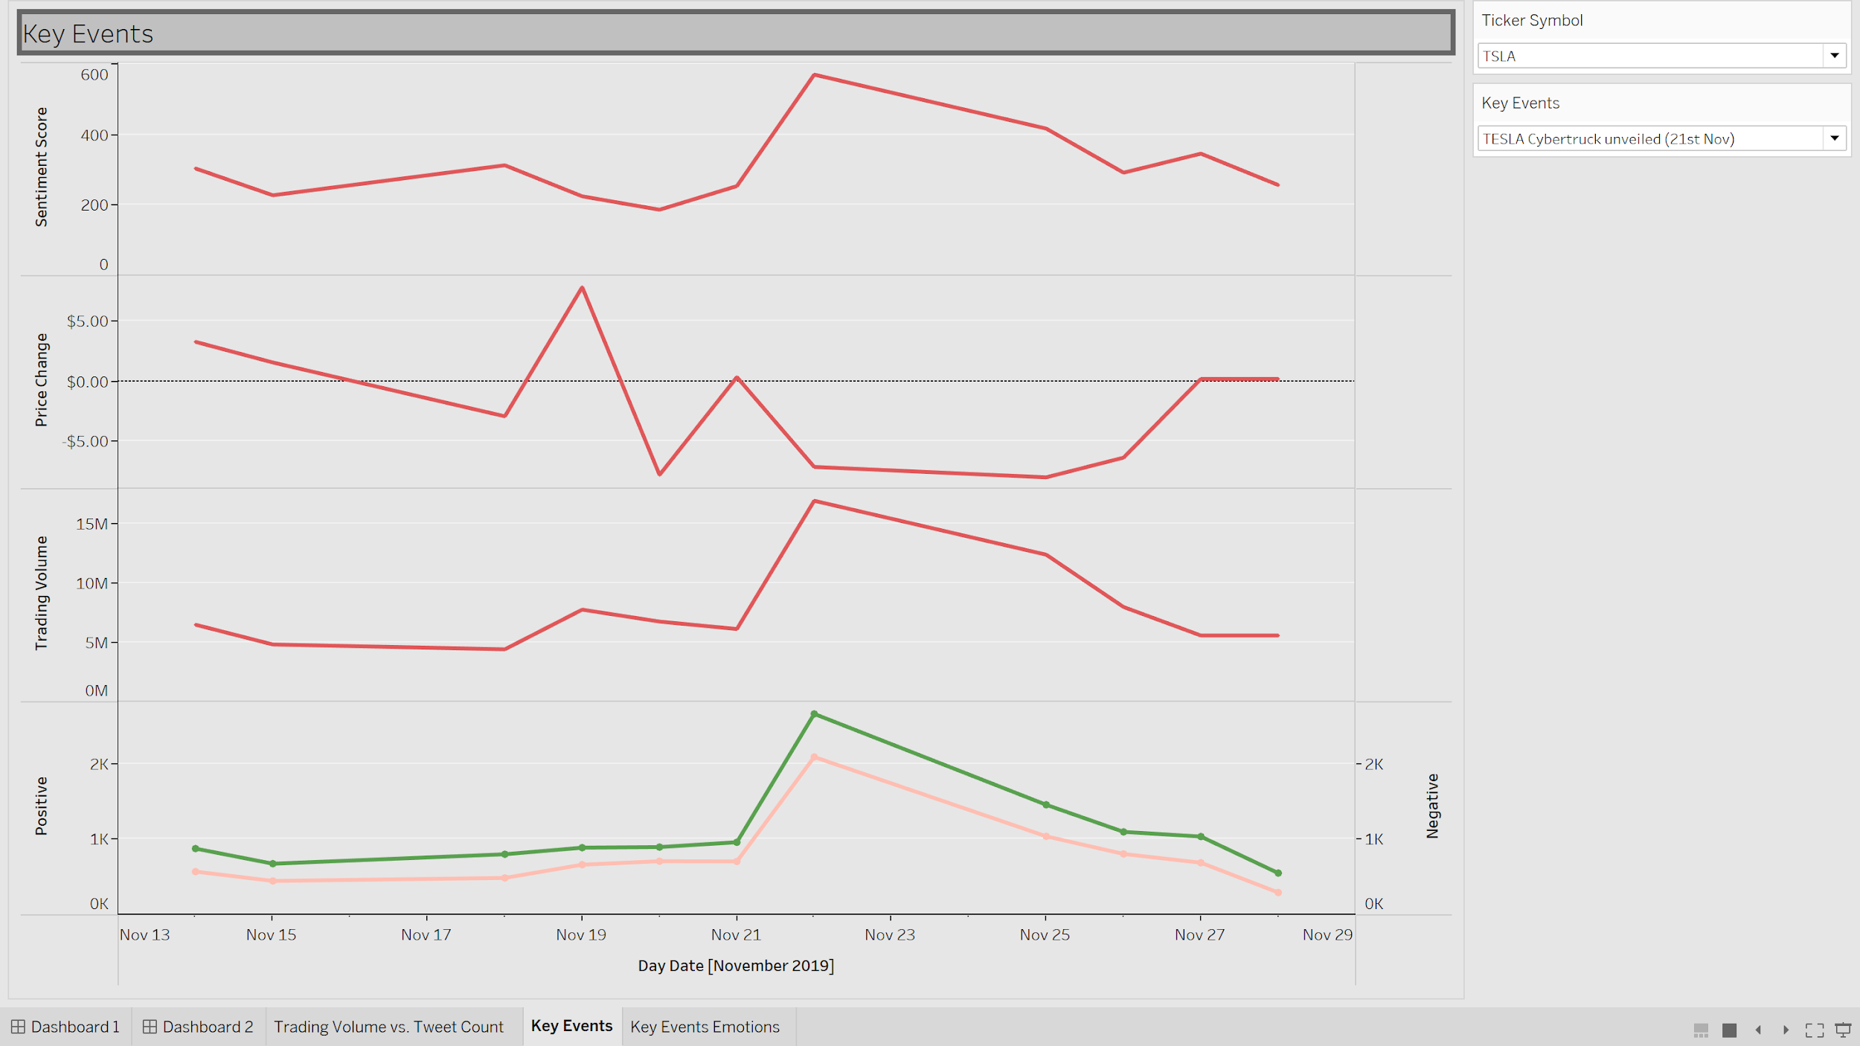
TESLA CYBERTRUCK LAUNCH

Slide 12
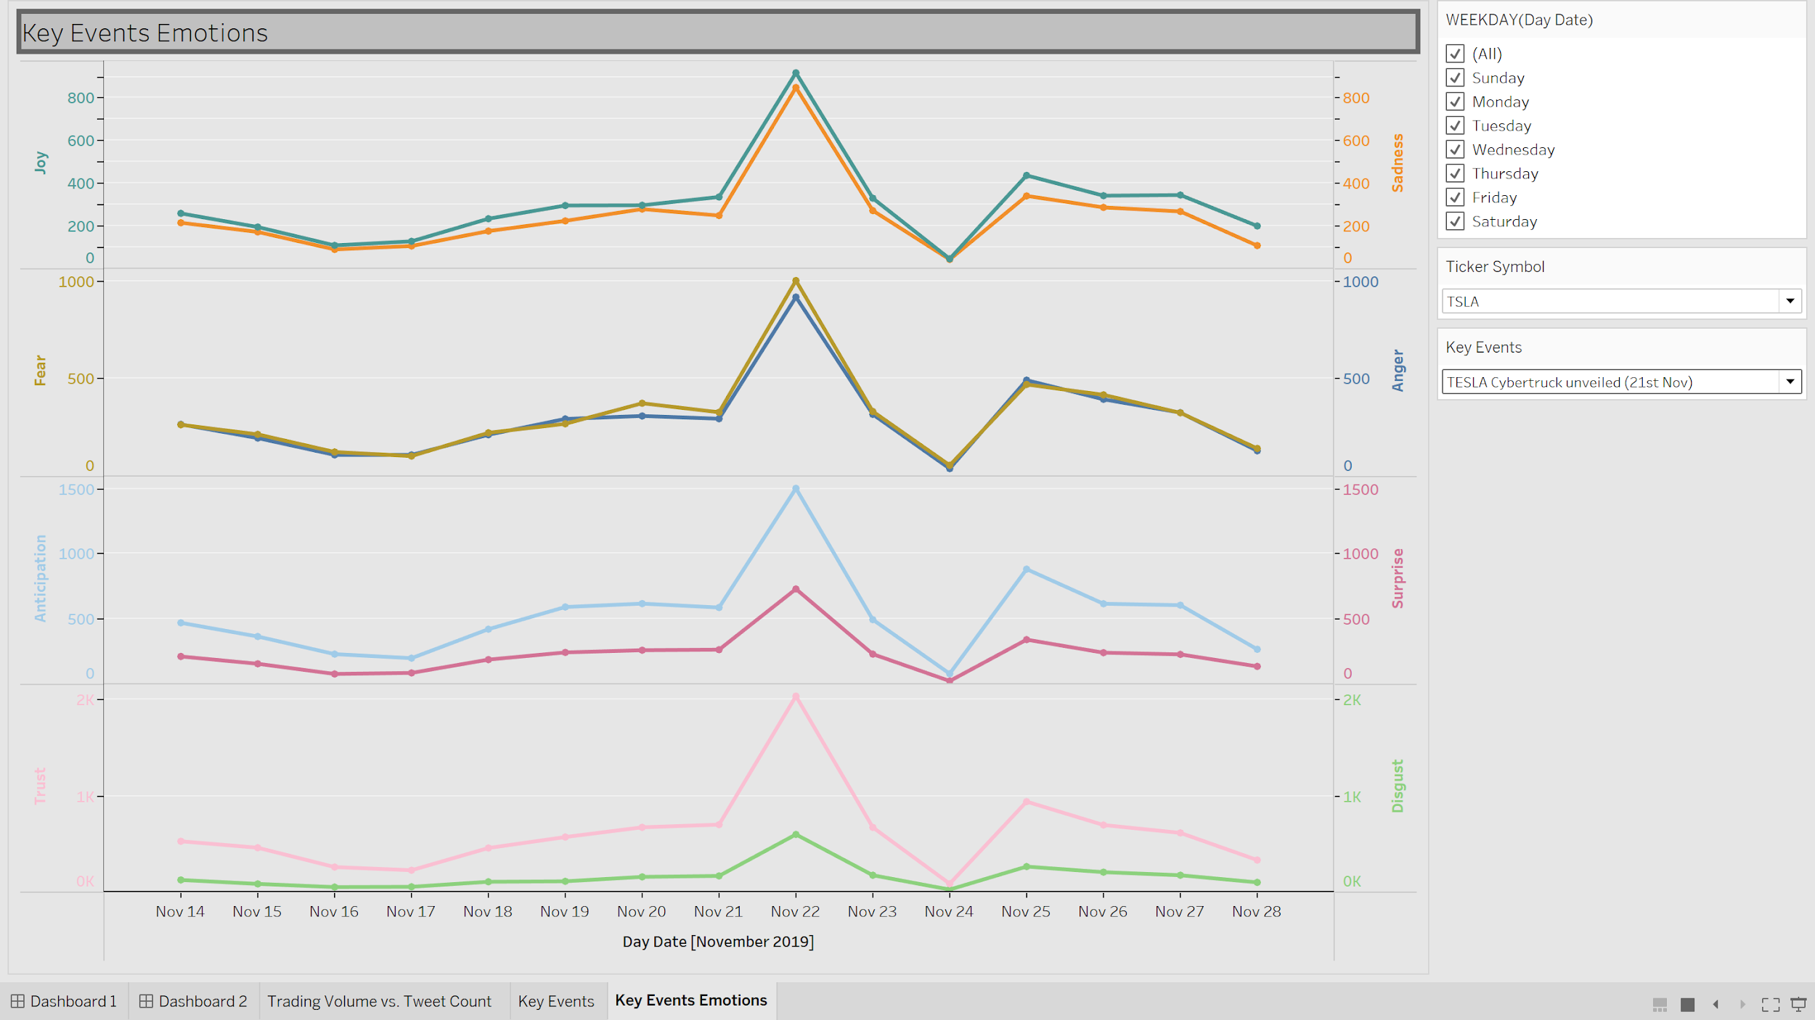
TESLA CYBERTRUCK LAUNCH

Slide 13
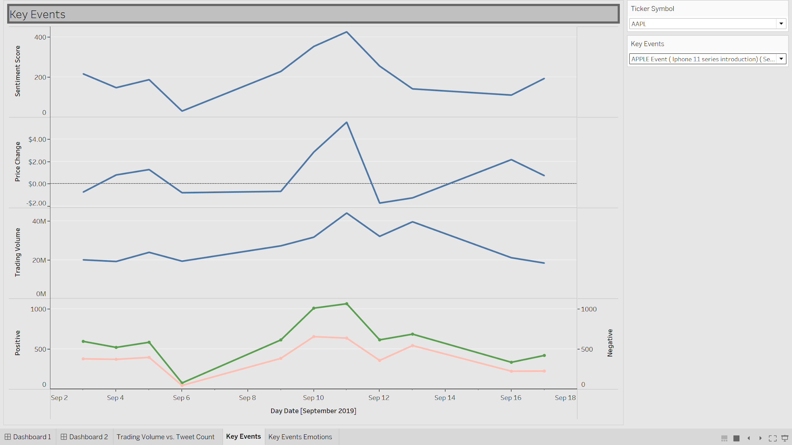
APPLE IPHONE 11 KEYNOTE

Slide 14
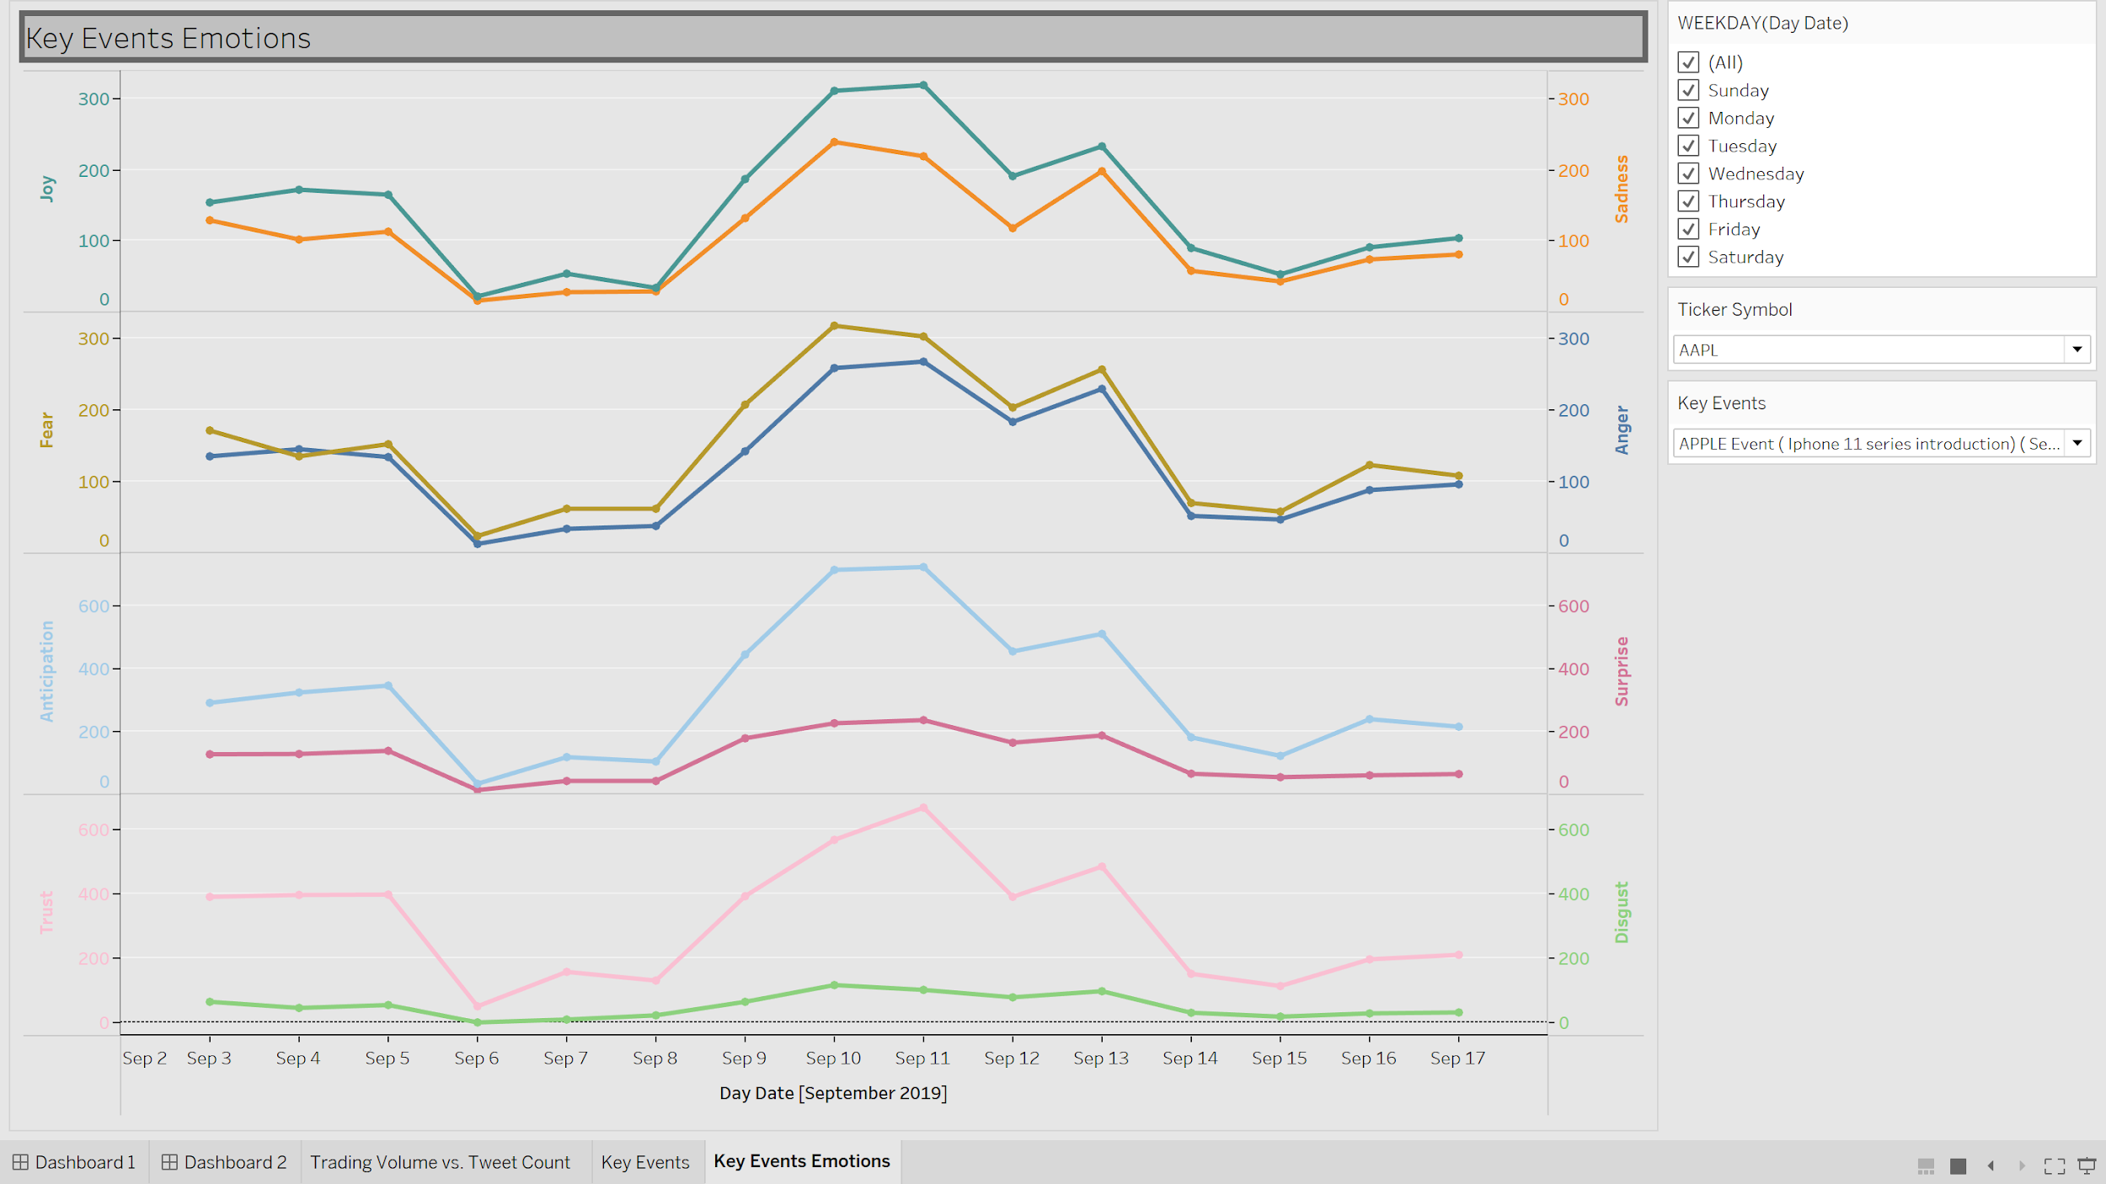
APPLE IPHONE 11 KEYNOTE

Slide 15


